Slide 1


Slide 2

HEALTHY FOOD
HOW CAN FOOD IMPACT
YOUR BODY & MIND?

Slide 3


What your body needs mostly is…
Proteins
Whole grains
Fruit and Vegetable

Slide 4


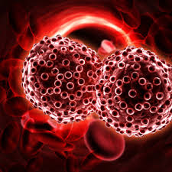
A recent study has proved that a healthy diet can
Diabetes
Heart disease
cancer

Slide 5



Consuming Fruits reduce risks for diabetes
The people eat fruit and vetgetable
The people eat Fast food
Person diabetes

Slide 6

Positmentalively affect our well-being.
Cognitive decline
Brain Health

Slide 7


Impacts our productivity and overall quality of life
increased focus
​​Improved memory

Slide 8


